Slide 1
UX evaluation and key opportunities
Shahil Kalebhai

Slide 2
Instructions
Evaluate the Denver Zoo’s website (denverzoo.org) using the UX Evaluation Spreadsheet. Then fill in this presentation with your findings.
You can edit the layout, fonts, colors, or visuals of the this presentation template however you’d like.
You must include one slide for each evaluation sub-category (19 total). I’ve included the names of each sub-category on the slides in this template.
You don’t need to have one positive and one negative statement for each sub-category. You can have two positive or two negative statements.
On each evaluation slide, include an image of the part of the Denver Zoo’s website that you’re referencing.
List 5 (or more) key opportunities for the Denver Zoo on the key opportunities slide.
Delete this instructions slide when you’re finished and submit as a .pdf.

Slide 3
Usability evaluation

Slide 4
Navigation and IA
Main navigation is generally easy to find and explore, and is consistent and persistent from page to page
The number of items in the main navigation are not reasonable because there 8 items and
Notes:
- Research informs design

Slide 5
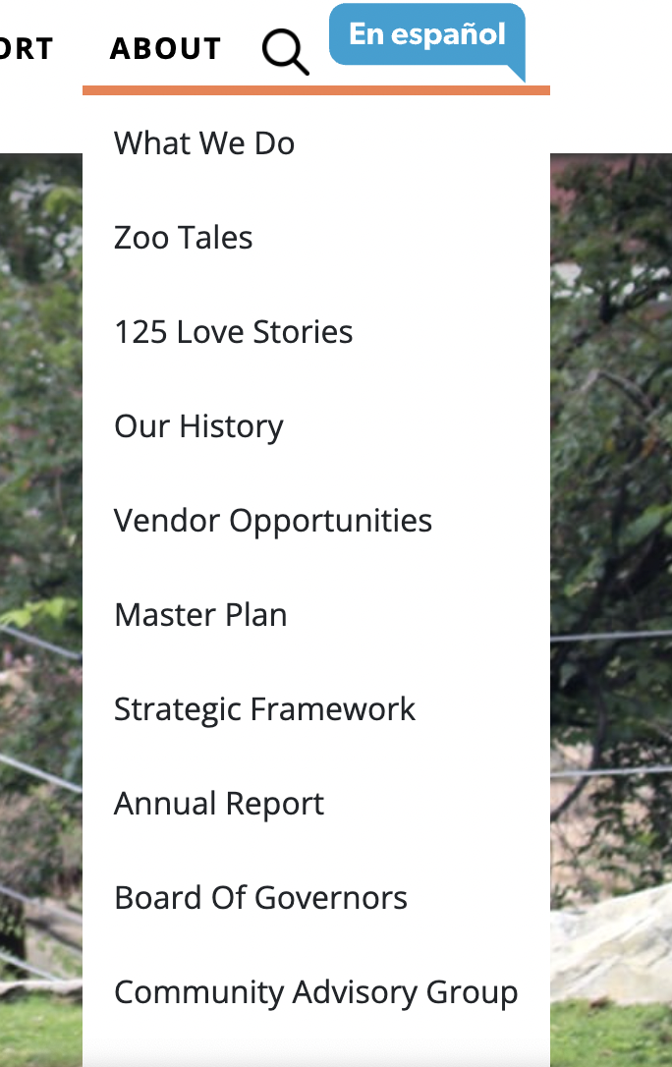
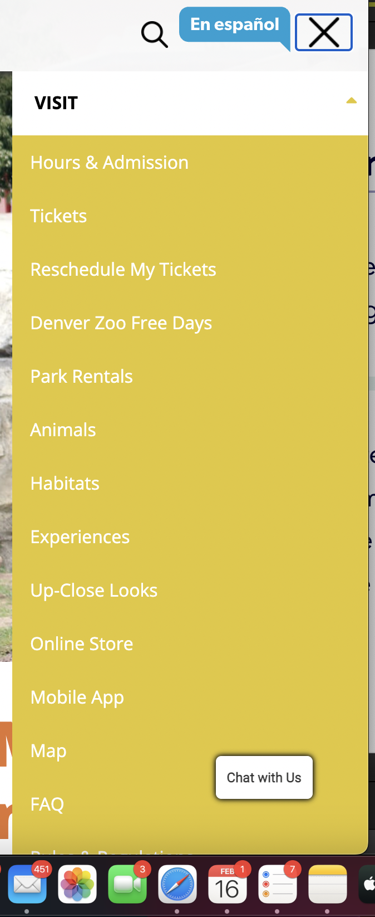
Navigation and IA
There are no more than 8 items per sub-navigation group
submenus does not work appropriately for responsive version
Notes:
- Research informs design

Slide 6
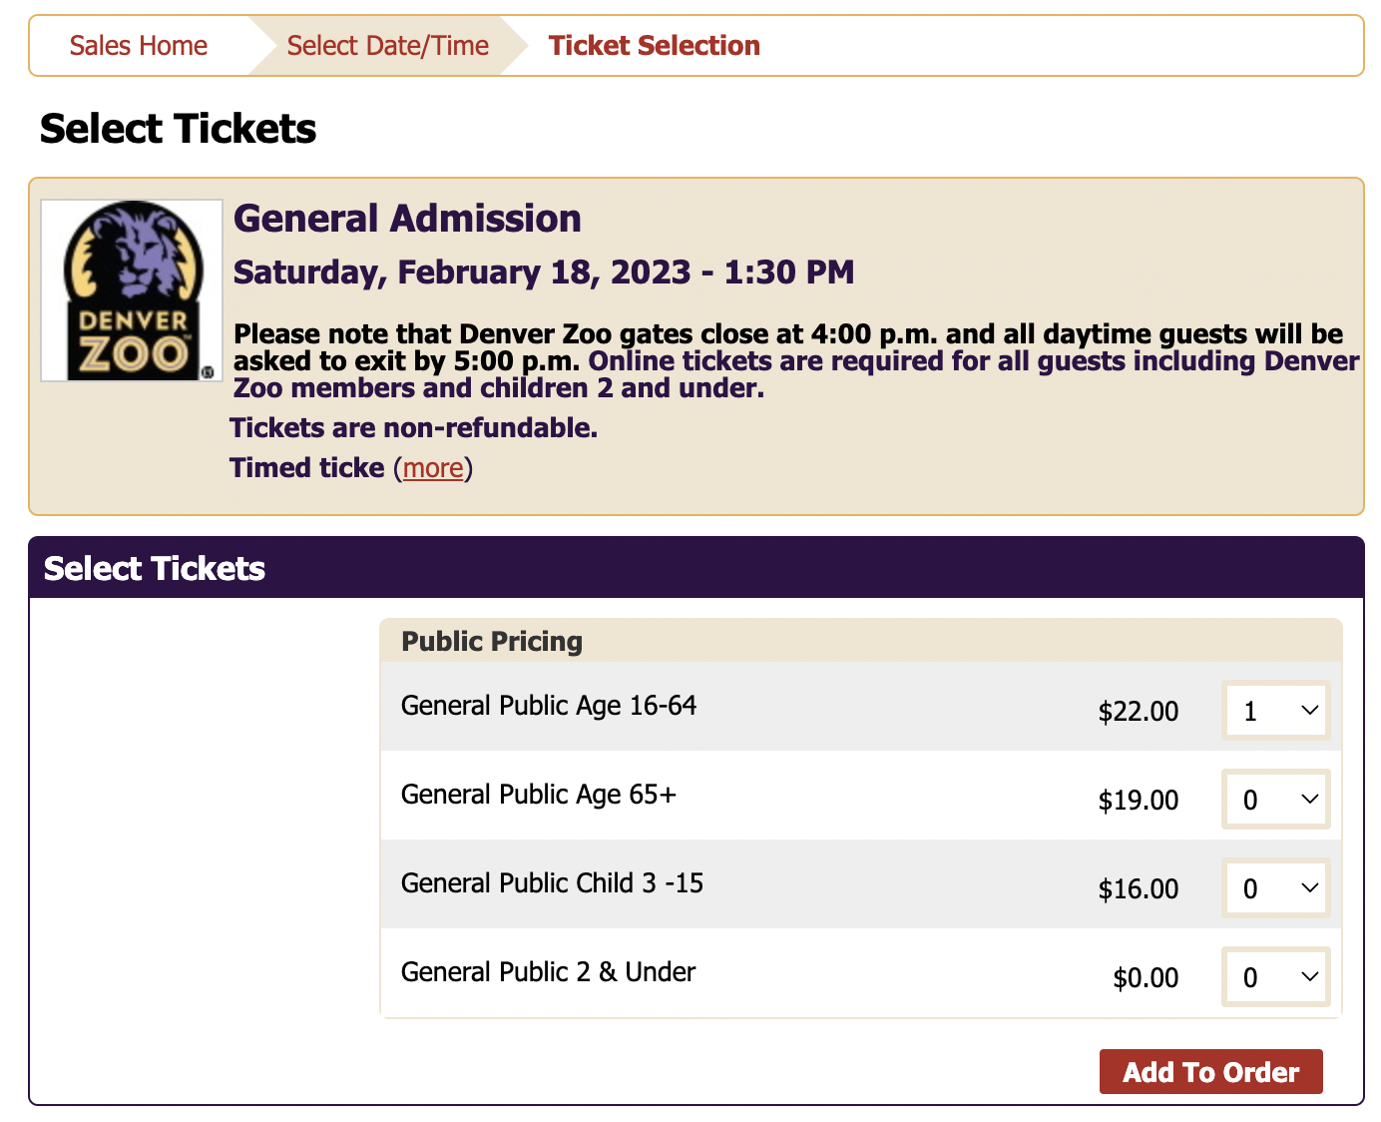
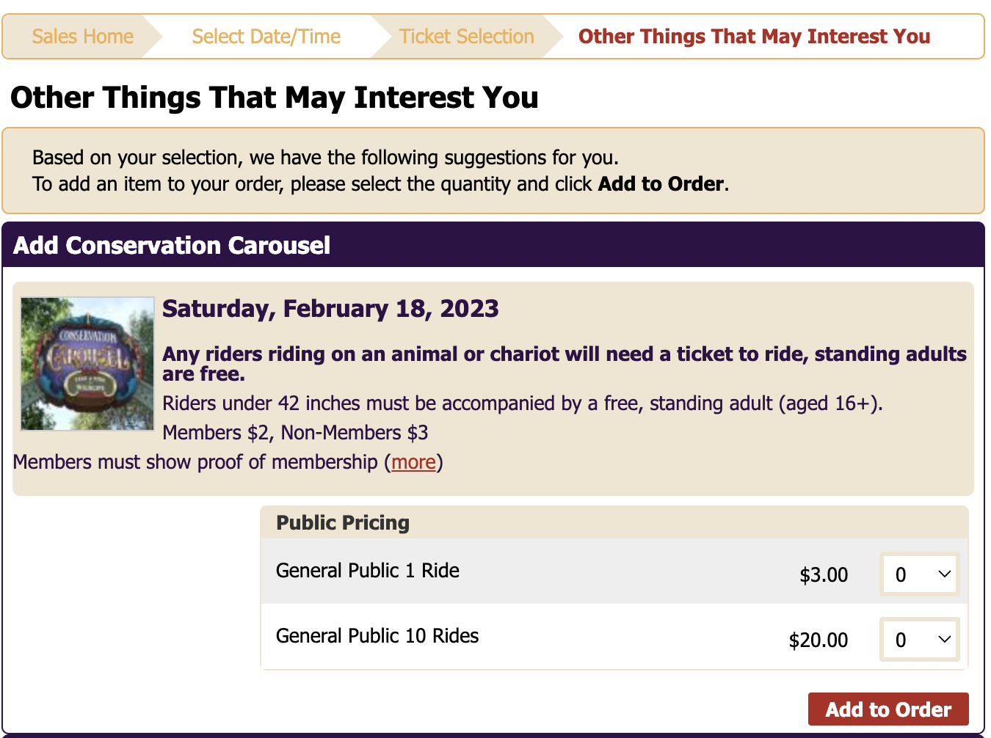
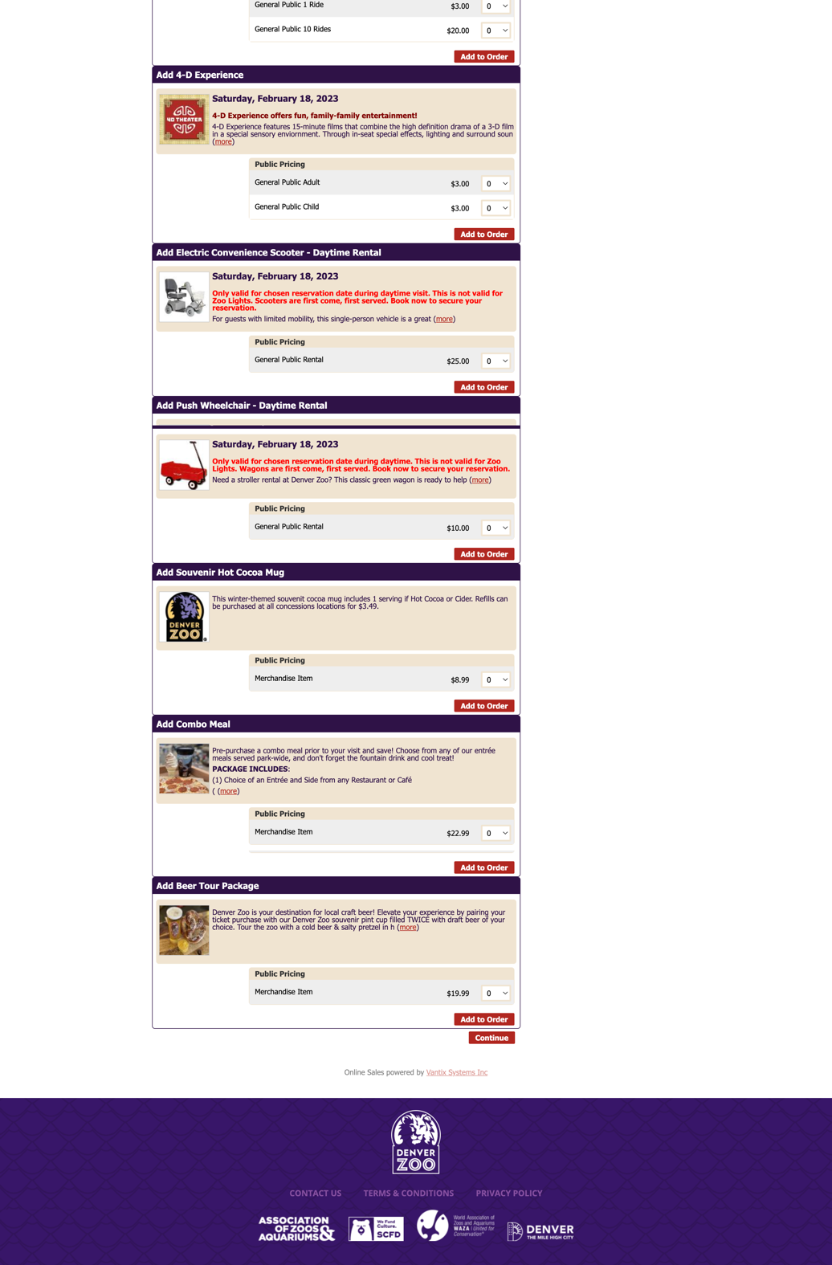
Task orientation
When there are multiple steps in a task, the site does not display all the steps that need to be completed.
The user has to go through a lot of scroll just to find the continue button after scroll.
Notes:
- Research informs design

Slide 7
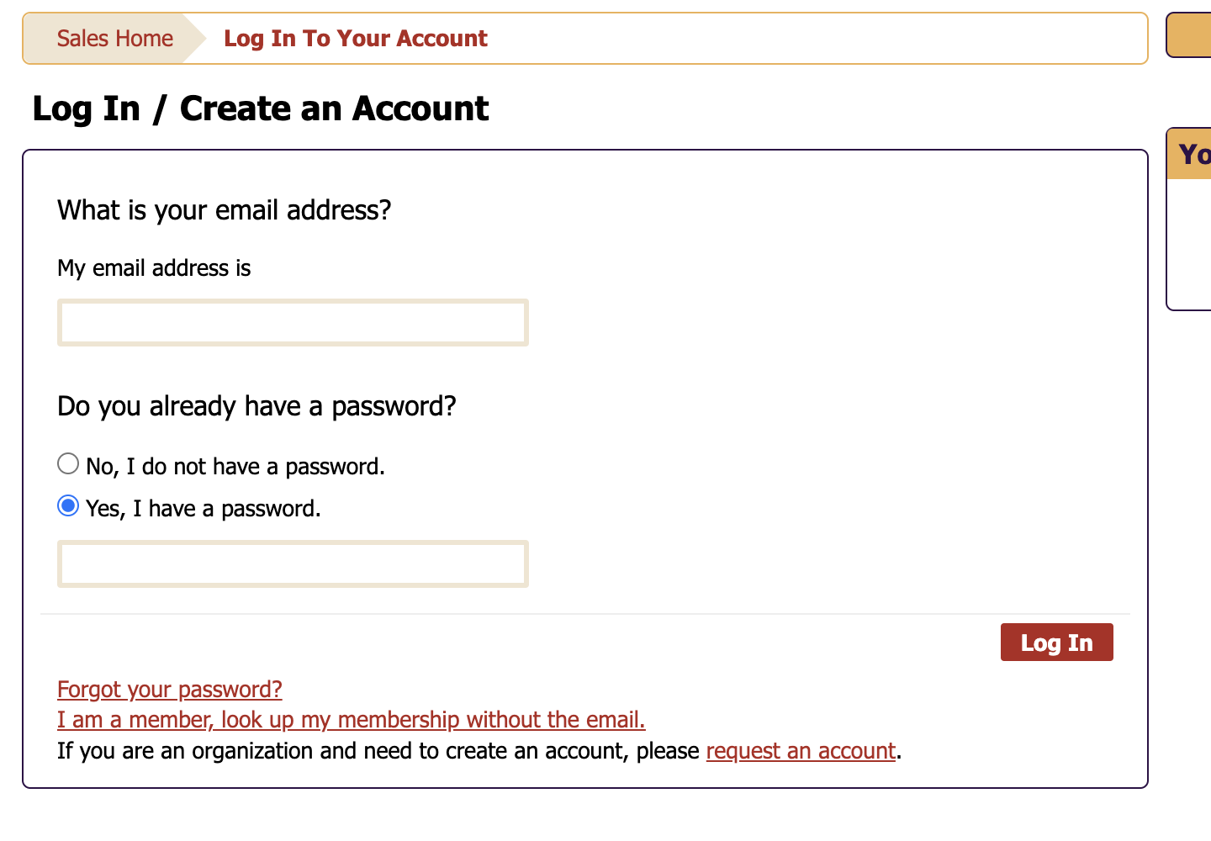
Help, feedback, and errors
No feedback or error if the user leaves the Coupon code blank
The page keeps loading for several seconds when I logged in without any information and there was no feedback or loader while the page was loading
Notes:
- Research informs design

Slide 8
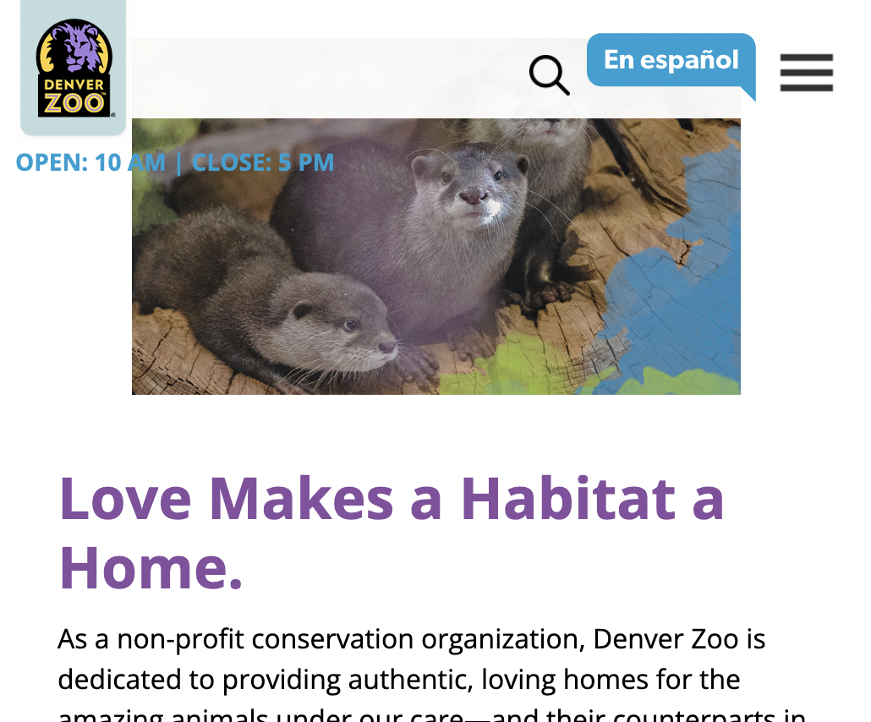
Accessibility and technical design
The zoo timings are displayed over the scrolling content on a responsive design
The site does not pass AA compliance when graded against WCAG 2.0 accessibility guidelines
Notes:
- Research informs design

Slide 9
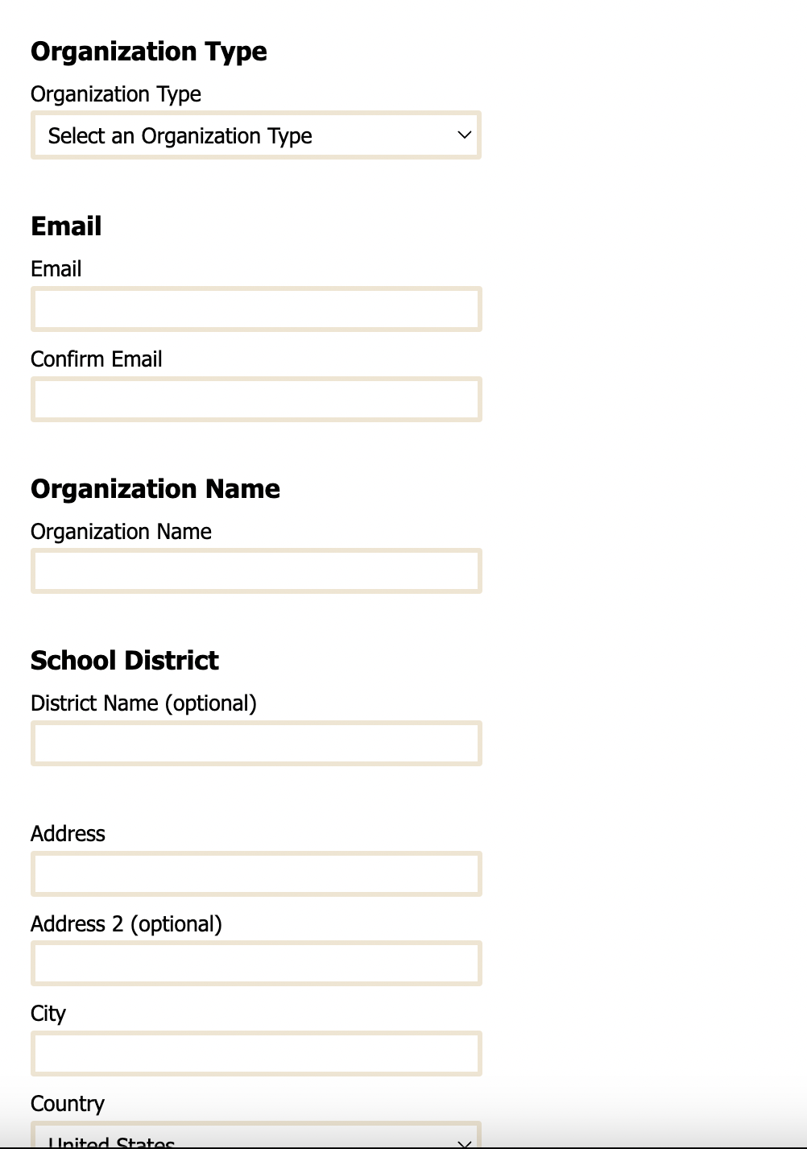
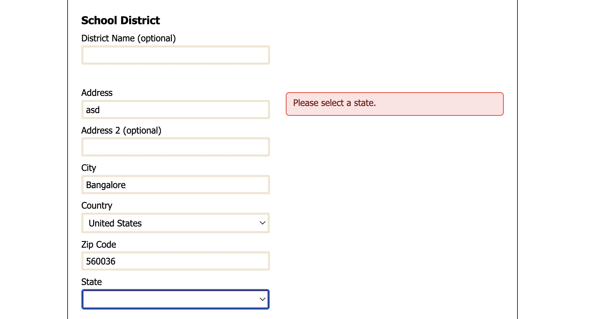
Forms and data entry
There is no clear distinction between required and optional fields on forms
State field was left blank but the error message was displayed at a different place
Notes:
- Research informs design

Slide 10
Findability evaluation

Slide 11
Searching
As a user begins typing, type ahead results are not presented to them.
It is not clear if the search box is searching the system globally or a specific portion of it
Notes:
- Research informs design

Slide 12
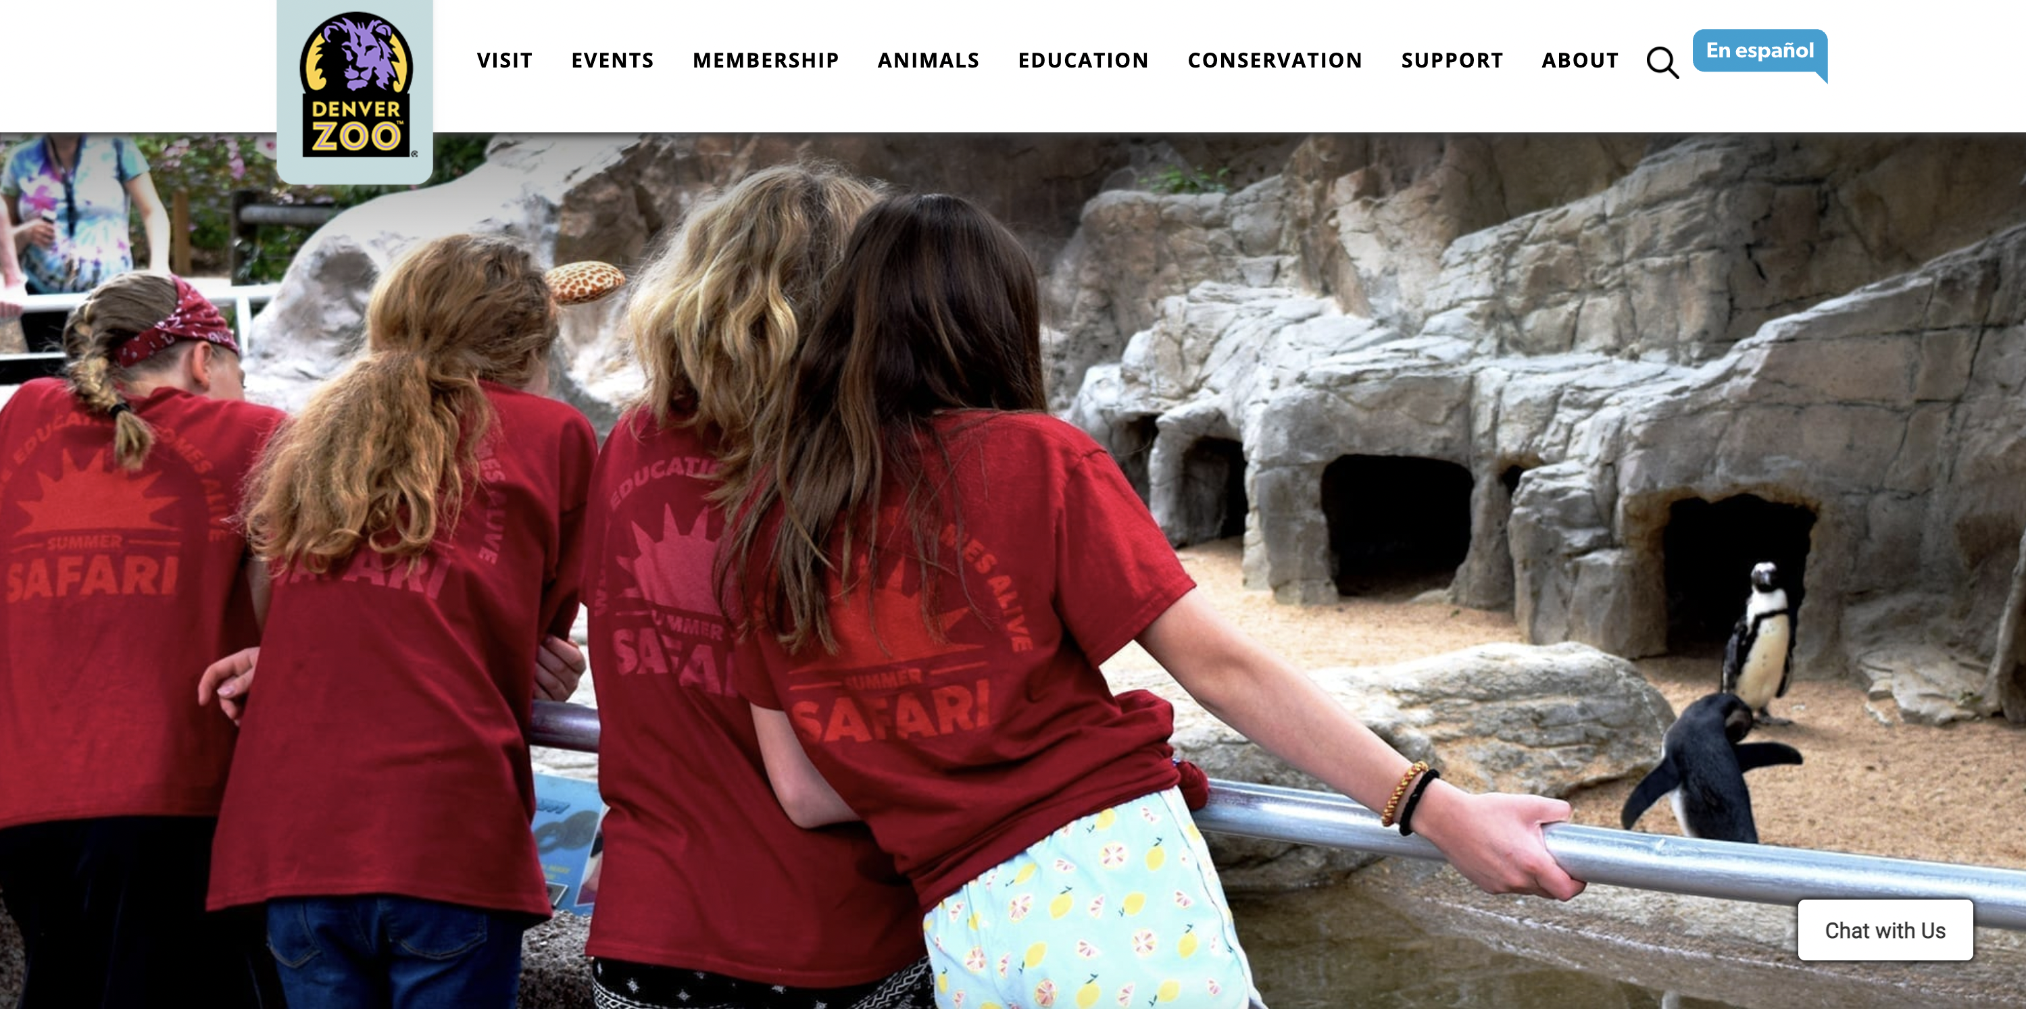
Results set
The search results page does not show what the user searched for and it is easy not possible to edit and resubmit the search
The search results are not shown and there is no feedback, and the page reloads with a huge block of image and results can be seen only upon scroll
Notes:
- Research informs design

Slide 13
Content findability
Navigation items and links are named in a way that is not subject to interpretation and the Information Architecture is not right because NAV Items are wrongly placed
Search or other grouped links are written in a clear, useful way that accurately represents the linked item
Notes:
- Research informs design

Slide 14
Visual design evaluation

Slide 15
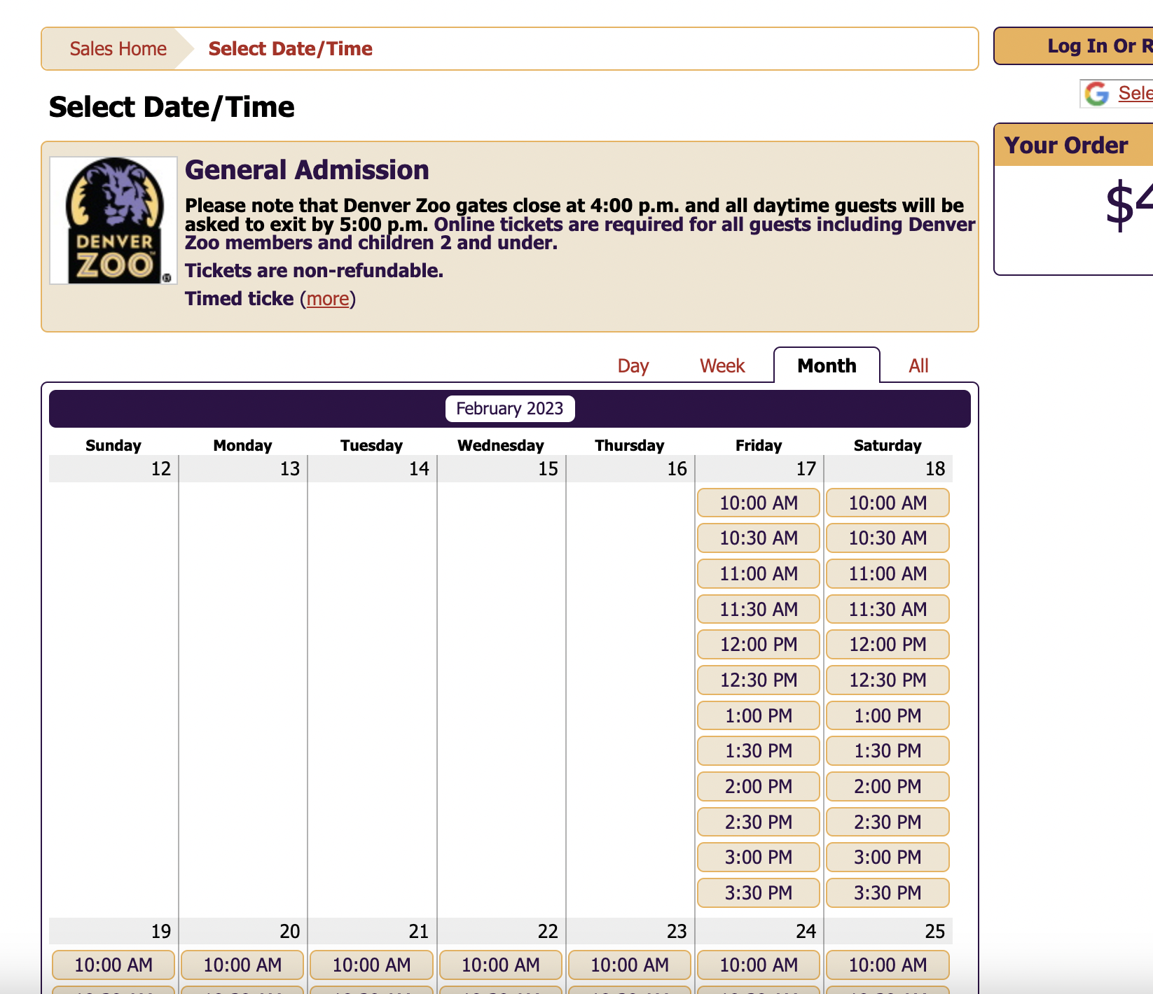
Content and layout
The screen density is not appropriate for the task
The layout does not help focus attention on what to do next
Notes:
- Research informs design

Slide 16
Color
The colors do not work well together
There is no consistent and meaningful use of brand colors and functional colors throughout the interface and visualizations (Each menu item has a different theme)
Notes:
- Research informs design

Slide 17
Font and typography
Fonts are not readable
The site has excessive use of upper case text
Notes:
- Research informs design

Slide 18
Imagery and iconography
Imagery is authentic, genuine, lifestyle-type imagery that does not use traditional "posed" stock photography
Imagery is diverse (ethnicity, age, locale, sexual orientation, socio-economic diversity when appropriate)
Notes:
- Research informs design

Slide 19
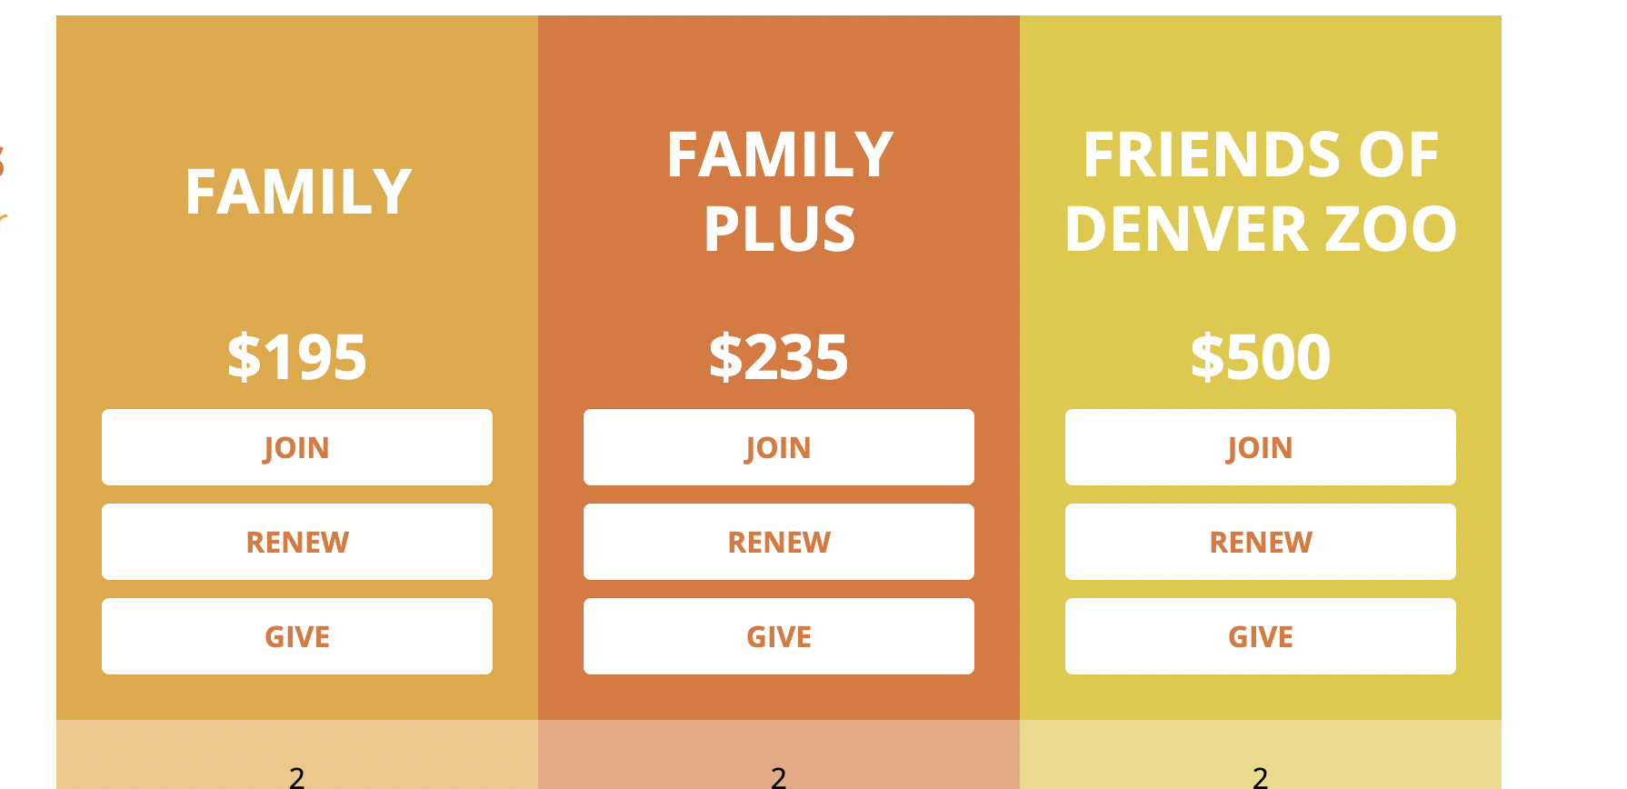
On-screen components
Styling of primary, secondary, and tertiary links follow a consistent pattern
Items that aren't clickable do not have characteristics that suggest they are
Notes:
- Research informs design

Slide 20
Brand identity
Company or application logo is prominently placed and in the same location on every page
Colors, fonts, and characteristics fit with the overall company brand experience but also distinguish this product as unique
Notes:
- Research informs design

Slide 21
Content evaluation

Slide 22
Meaningful content
Headings and sub-headings are short, straightforward and descriptive
The system speaks the users’ language in familiar words, phrases, and concepts
Notes:
- Research informs design

Slide 23
Technical writing
Grammar standards are consistent throughout (Oxford commas, conjunctions, etc.)
The site is free of typographic errors and spelling mistakes
Notes:
- Research informs design

Slide 24
Trust and credibility
The content is up-to-date
The site avoids excessive advertisements, especially pop-ups
Notes:
- Research informs design

Slide 25
Key opportunities

Slide 26
Key opportunities
Enhanced User Experience: The website can be designed to provide a more engaging and intuitive user experience, making it easier for visitors to navigate and find the information they are looking for.
Increased signup/registrations : The website can be optimized to encourage make the signup easier
Improved Visual Design: The website Visual design can be improved to have a a better design system which will help have consistent UI
Increased Engagement: The website can be used to foster a sense of community among zoo visitors and to encourage them to share their experiences and knowledge with others. This can be achieved through interactive features such as forums, social media integration, and live streaming of zoo events.
Accessibility :. The accessibility can be fixed to make sure it follows AAA standard

